Slide 1
Data and Web Application CC6012
Dr Rattapol Kasemrat

Slide 2
Content
What is a Framework?
History of .Net Core
Why .Net Core for Web Application
Visual Studio 2022

Slide 3
What is a web development framework ?
Top frameworks for web application development. Web Application Framework is intended to help the advancement of web applications, including web services, web assets, and web APIs. Frameworks are, so, libraries that assist you with building up your application quicker and more intelligent!
A framework might be for a lot of capacities inside a framework and how they interrelate; the layers of a working framework; the layers of an application subsystem; how correspondence ought to be institutionalized at some level of a system, etc. A framework is commonly more far-reaching than a convention and more prescriptive than a structure.

Slide 4
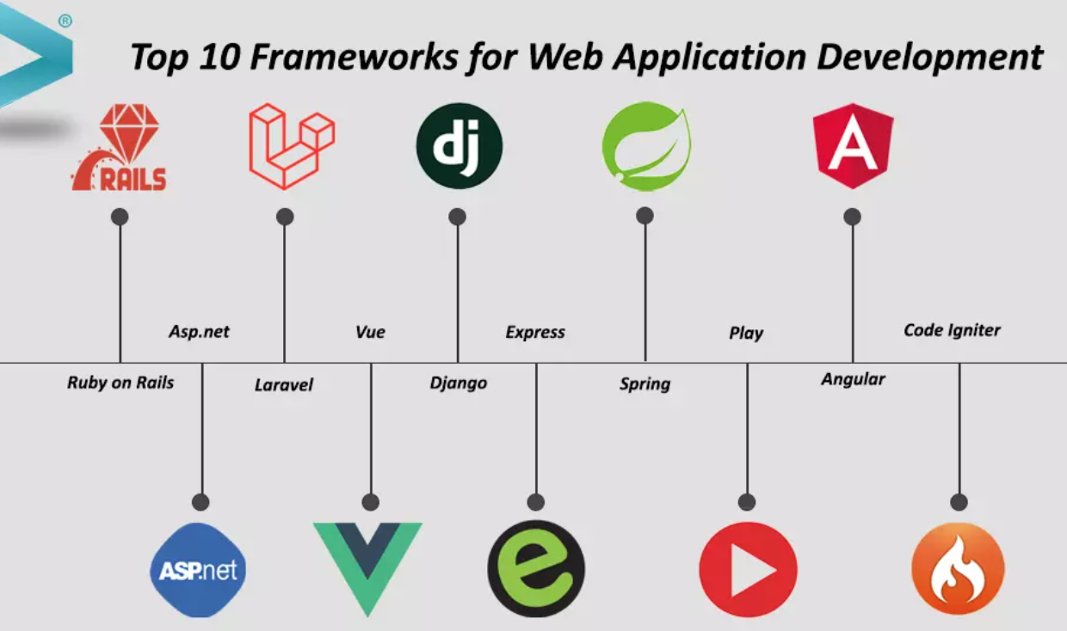
Web application development frameworks
ASP.NET Core: ASP.NET Core is a cross-platform framework from Microsoft for building web applications, APIs, and microservices. It's known for its performance, modularity, and integration with Visual Studio. ASP.NET Core supports both MVC and Web API development
Django: Django is a high-level Python framework that promotes clean, pragmatic design. It provides tools for handling complex web applications while encouraging best practices and efficient development. Like Rails, it follows the MVC pattern.
Ruby on Rails (Rails): Also known as Rails, this open-source framework is built on the Ruby programming language. It emphasizes convention over configuration and follows the MVC architectural pattern. Rails is known for its simplicity and productivity, making it a favorite for startups and rapid development.
React: React is a JavaScript library maintained by Facebook that's used for building user interfaces, particularly in SPAs. It focuses on component reusability and efficient rendering, making it a popular choice for front-end development.
Angular: Angular is a JavaScript framework maintained by Google for building dynamic and interactive single-page applications (SPAs). It follows the component-based architecture and offers features for data binding, routing, and more
Flask, Spring Boot, Laravel …

Slide 5
A brief history of ASP.Net core
ASP.NET (Web Forms and MVC)
↓
ASP.NET vNext
↓
ASP.NET Core 1.0
↓
ASP.NET Core 2.0 and Beyond
↓
ASP.NET Core MVC

Slide 6
A brief history of ASP.Net core
ASP.NET Web Forms and MVC: ASP.NET was originally introduced by Microsoft in the early 2000s with two main web development models: ASP.NET Web Forms and ASP.NET MVC (Model-View-Controller). Web Forms focused on simplifying web development with a drag-and-drop model, while MVC provided a more structured and testable approach.
ASP.NET Core Announcement: In 2014, Microsoft announced ASP.NET vNext, which aimed to merge the best aspects of Web Forms and MVC, while also embracing modern web development practices. It would become the foundation of ASP.NET Core.
ASP.NET Core 1.0: ASP.NET Core 1.0 (initially named ASP.NET 5) was officially released in June 2016. It was a complete rewrite of the ASP.NET framework, designed to be cross-platform, modular, and high-performance.

Slide 7
A brief history of ASP.Net core cont.
ASP.NET Core 2.0 and Beyond: Subsequent releases, including ASP.NET Core 2.0 and beyond, introduced improvements, features, and enhancements. These versions focused on performance optimization, improved tooling, enhanced MVC capabilities, and the expansion of cross-platform support.
Unified .NET Core and .NET Framework: With the release of ASP.NET Core 2.0, Microsoft aimed to provide a unified experience for both .NET Core (cross-platform) and .NET Framework (Windows-only) developers. This was intended to simplify development and enable easier migration from previous versions of ASP.NET.
Renaming to ASP.NET Core MVC: In September 2016, Microsoft announced that the framework would be renamed to ASP.NET Core MVC to clarify its association with the MVC pattern. This renaming reflects the framework's focus on modern architecture and patterns.
Continued Evolution: Microsoft has continued to enhance and develop ASP.NET Core MVC with regular updates, adding new features, performance improvements, and integrations with other technologies.

Slide 8
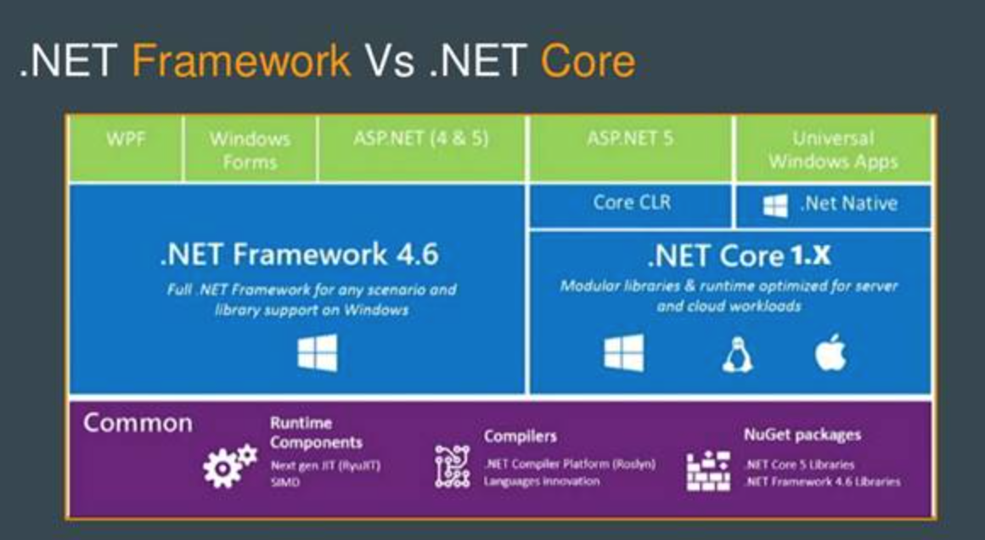
.Net Framework vs .Net Core
.NET Framework is primarily designed for Windows environments. It's not cross-platform and only runs on Windows operating systems. .NET Core is designed to be cross-platform and can run on Windows, macOS, and Linux. It provides more flexibility for choosing development and deployment environments.

Slide 9
Why ASP.NET Core for web application?
ASP.NET Core offers a modern, performance, and cross-platform framework for building web applications. The choice to use it depends on the specific needs of your project, but its versatility, performance, and strong tooling make it a compelling option for many developers.
Cross-Platform Compatibility: ASP.NET Core is designed to be cross-platform, meaning it can run on Windows, macOS, and Linux environments. This flexibility allows developers to choose their preferred development and deployment platforms.
Performance: ASP.NET Core is optimized for high performance. It has a lightweight and modular architecture that enables faster startup times and lower memory usage. This makes it suitable for building scalable and responsive web applications.

Slide 10
Why ASP.NET Core for web application? Cont.
Open-Source: ASP.NET Core is open-source and hosted on GitHub. This openness encourages collaboration, community contributions, and continuous improvement
Modern Development Patterns: ASP.NET Core embraces modern development patterns like dependency injection, which makes it easier to manage application components and improve testability and maintainability.
Unified Framework: ASP.NET Core combines the best of ASP.NET MVC and Web API into a single unified framework. This simplifies the development of both web pages and APIs within the same application.
Built-in Dependency Injection: ASP.NET Core includes a built-in dependency injection container, making it easier to manage dependencies and promote the use of best practices in software design.

Slide 11


Dependency Injection
You run a juice bar. Every day, you make smoothies. But instead of growing your own bananas, strawberries, and spinach, you have them delivered to you by your trusted suppliers.
You just ask for what you need, and they bring it.
public class OrderService {
private IEmailService email;
public OrderService(IEmailService emailService) {
email = emailService; // someone gives it to you!
}
}
public class OrderService {
private EmailService email = new EmailService(); // makes it itself!
}
Why It’s Awesome
You don’t have to worry about how things are made — just what you need
Your code becomes cleaner, simpler, and easier to update
You can test parts of your app without the rest of it running

Slide 12
Why ASP.NET Core for web application? Cont.
Support for Microservices: ASP.NET Core is well-suited for building microservices architectures due to its modularity and lightweight nature. This enables developers to create loosely coupled, independently deployable services.
Middleware: ASP.NET Core uses middleware components that allow developers to easily plug in various functionalities into the request processing pipeline, such as authentication, logging, and caching
Flexible Hosting: ASP.NET Core supports different hosting models, including self-hosting, IIS, and Docker containers. This adaptability is useful for various deployment scenarios.
Strong Tooling: ASP.NET Core is supported by a rich set of development tools, including Visual Studio and Visual Studio Code, which provide robust debugging, profiling, and deployment capabilities

Slide 13
Why ASP.NET Core for web application? Cont.
Security: ASP.NET Core includes built-in security features like data protection, authentication, and authorization mechanisms, helping developers build secure applications.
Community and Resources: ASP.NET Core has a large and active community, which means you can find extensive documentation, tutorials, and libraries to assist in your development journey.

Slide 14
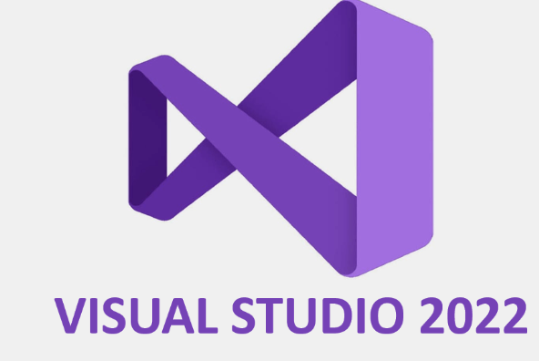
What is Visual Studio 2022 ?
Microsoft's integrated development environment (IDE), following Visual Studio 2019. It has new features, enhancements, and improvements to support various types of software development, including desktop applications, web applications, cloud development, mobile apps, games, and more.
Contains features such as :
Performance Improvements
64 bits version
Major UI icons
.Net Integration
Muti monitor support
AI-assisted code
Enhanced Debugging
Enhanced Web Development
Cloud integration

Slide 15
Download Link
Free Community Edition VS2022 for Web Application
https://visualstudio.microsoft.com/vs/community/

Slide 16
Thank You…

